Slide 1
Choose Your Own Fate!
Janabelle

Slide 2

Demo

Slide 3
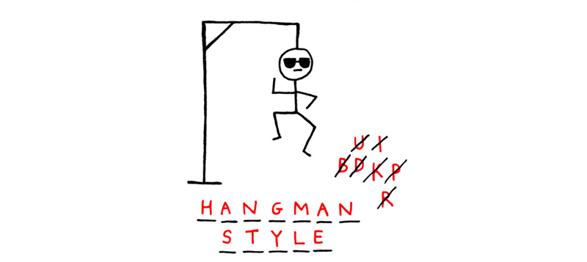
Last Week Recap
If-elif-else statements
User inputs
Random
sys and sys.exit(0)
Notes:
If elif else statements changes the flow of the code and in our case it changes our storyline
It gives you what the user inputs as answer and you decide what you want to do with that answer
Random picks a random number or item in your list
Importing sys and putting sys.exit(0) make sure your code exits correctly

Slide 4
Time
Random
import time at the top of your python file, you include the time library
For this game we will be using
time.sleep( NUM )
This stop the program from running for the NUM of seconds you put in
The reason we need this for this game, so we make the story flow better and with suspense
We talked about random last week
We used random.choice( [1,2,3,4,5] )
NEW: random.randint (1, 20)
This returns a random number from 1 to 20, inclusive

Slide 5
Homework
Your turn!
Make your own adventure story from scratch
Try to think of a short story like mine (person goes in cave, meets zombie, come out dead or alive)
Remember to make sure you give your user choices
You can use my code for reference

